Slide 1
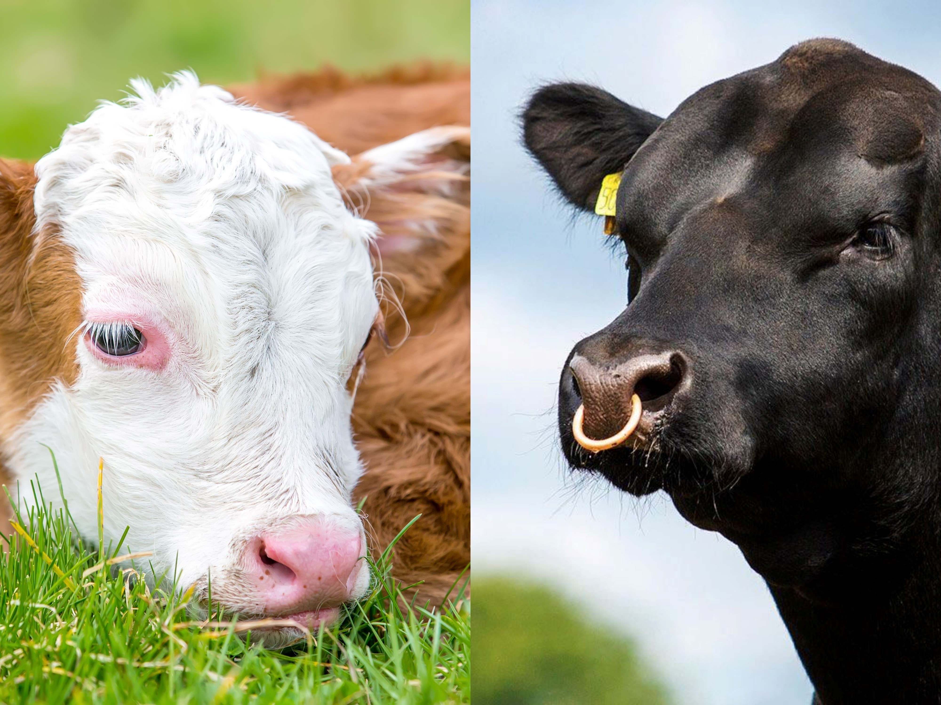
Some Actualities and
Challenges in Sustainable Beef Cattle Breeding and Husbandry
1 ˢᵗ Conference on Sustainability COS ’23
Judit Márton, Ferenc Szabó
Department of Animal Sciences, Albert Kázmér Faculty, Széchenyi István University, 9200 Mosonmagyaróvár, Hungary

Slide 2
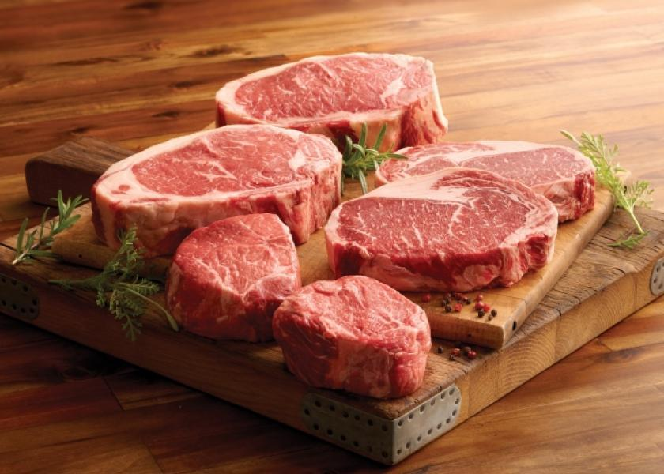
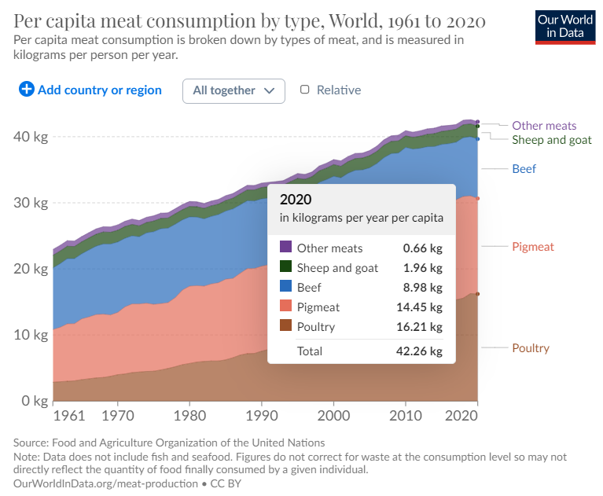
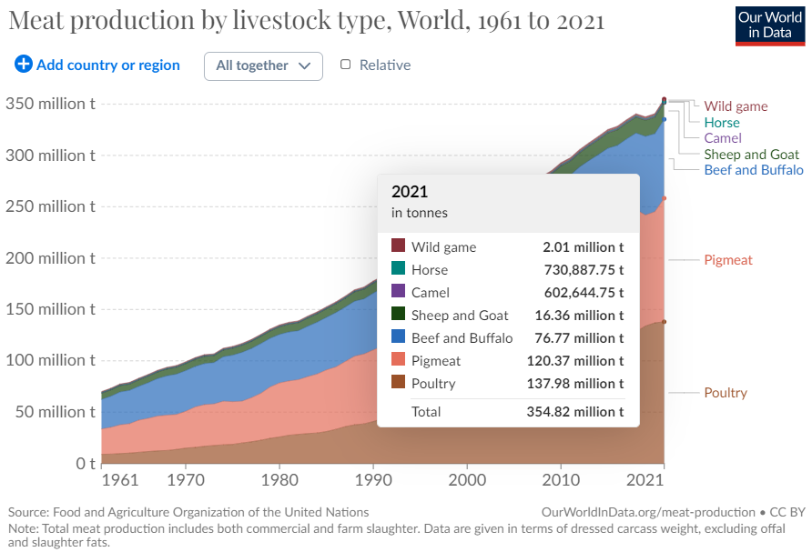
The Evolution of World Beef Production and Beef Consumption from 1960 to Present
1 ˢᵗ Conference on Sustainability COS ’23
Since the 1960s, there has been a 1.6 percent/year increase in beef production for cattle.
Beef and buffalo meat as a share of total meat production has nearly halved, now 22 %.
Decreasing per capita beef consumption

Slide 3
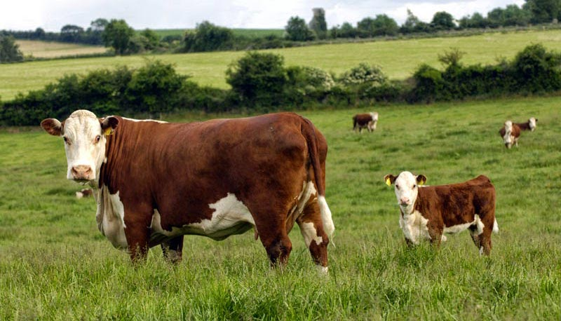
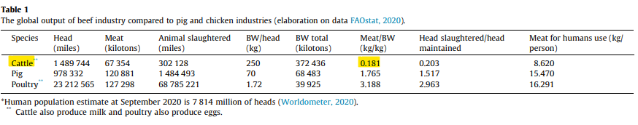
1 ˢᵗ Conference on Sustainability COS ’23
The global output of beef industry compared to pig and chicken industries
G. Pulina et al. (2021)
The main limitations of beef industry include low reproductive live weight output, significantly lower productivity, longer production cycle compared to other animals.
Increasing the output of current systems would mean serious environmental damage.

Slide 4
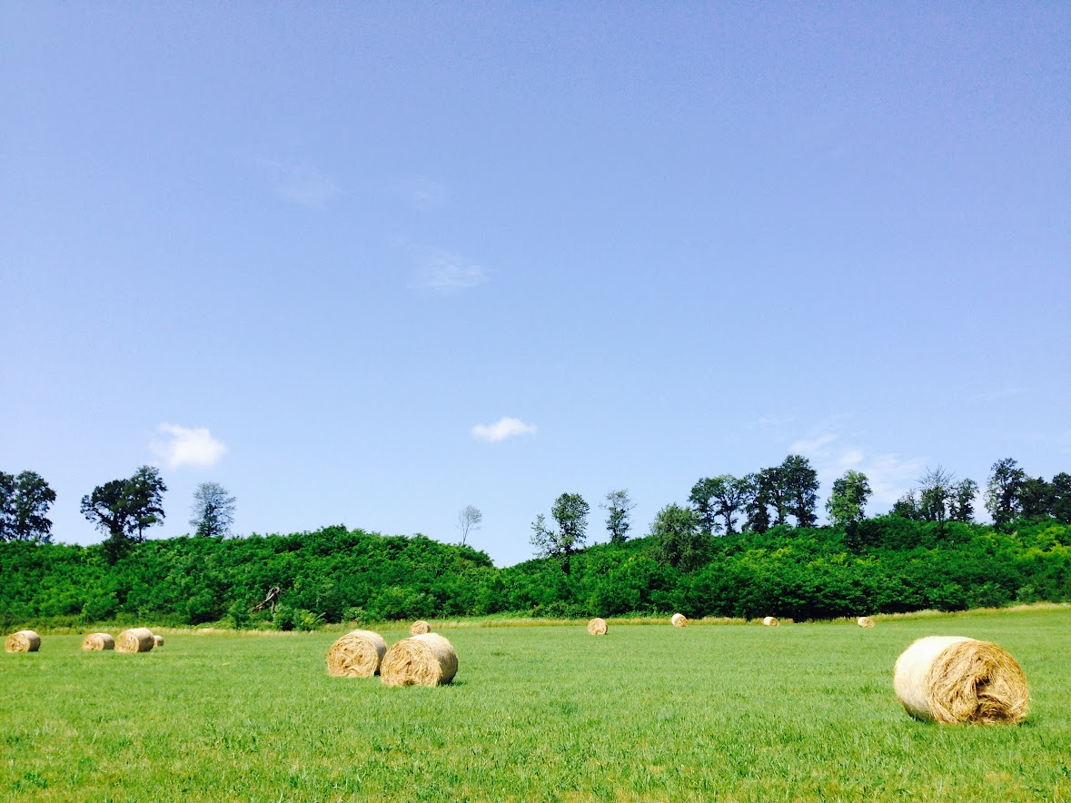
Some features and facts related to beef cattle production
1 ˢᵗ Conference on Sustainability COS ’23
Population Growth: by 2050 nearly 10 billion, indicating a 30% increase over 40 years, higher food demand and environmental challenges.
Environmental Challenges: desertification, urban expansion, soil degradation -24 million hectares/year of agricultural land annually from 1960 to 2021. Europe decrease by 25%, Africa increase by 46%, Asia by 36%, South America by 83%.
Cattle Farming: Cattle farming is a critical source of livelihood in several regions, eg. S. Africa, France, Spain, Ireland, UK, N. America.
U.S. Beef Production: U.S. farmers are responsible for 20% of the world's beef production, despite having only 6% of the world's cattle stocks. Interestingly, their cattle stock is 53% smaller than it was in 1975.

Slide 5
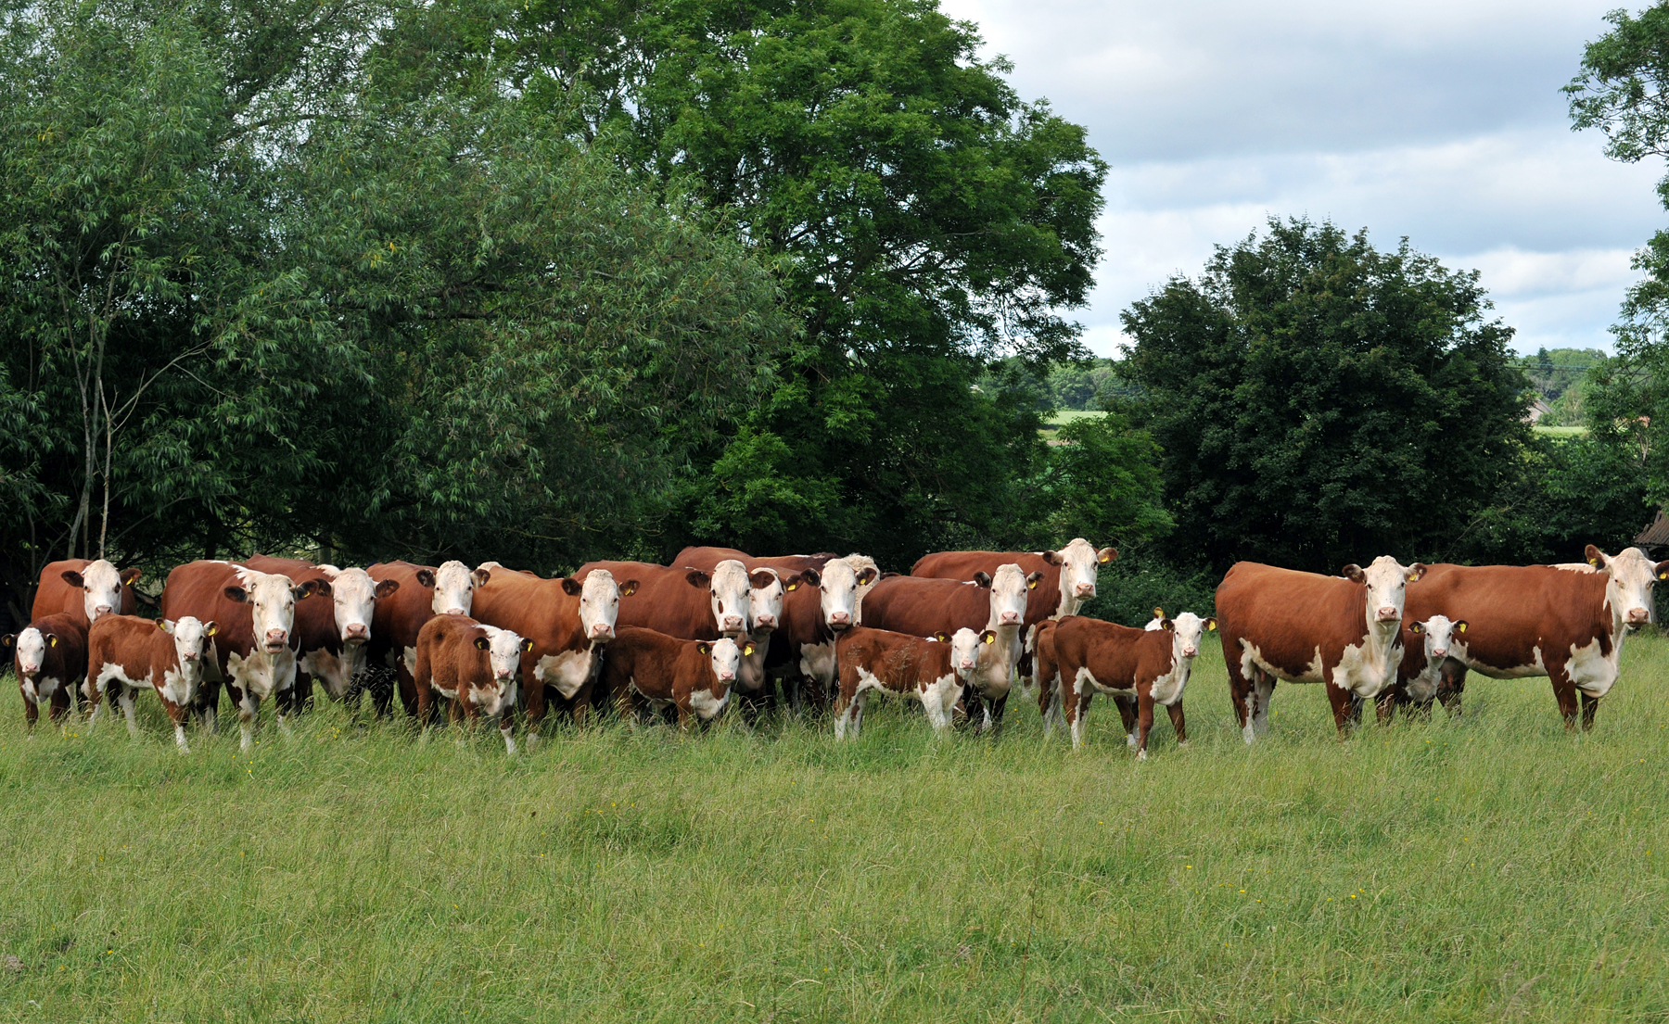
  Pillars of sustainability
1 ˢᵗ Conference on Sustainability COS ’23
Social Responsibility
Economic Viability
Environmental Awareness
A fourth pillar, that is the cultural sustainability is examined, how it can be incorporated into the model.
The three basic pillars are closely connected with each other, and it is crucial to reach a balance among them. If one of them is not met, there is no long-term sustainability.

Slide 6

Social Responsibility
1 ˢᵗ Conference on Sustainability COS ’23
Social Capital: Cattle breeding is a primary livelihood in some regions in South Africa, Spain, the UK, North America. In the USA, beef cattle breeding contributes $24.5 billion annually through ecosystem services.
Workforce and Working Conditions: Challenges include labor migration, an aging farming population (only 10% under 40 in the EU), job commitment, skilled labor shortages, and wage disparities.
Food Security: Excessive consumption of processed food and red meat causes 3.8% of deaths in the EU, compared to 14% from smoking.
Inequality: 2 billion overweight, 1 billion undernourished, and 30% with anemia globally.

Slide 7
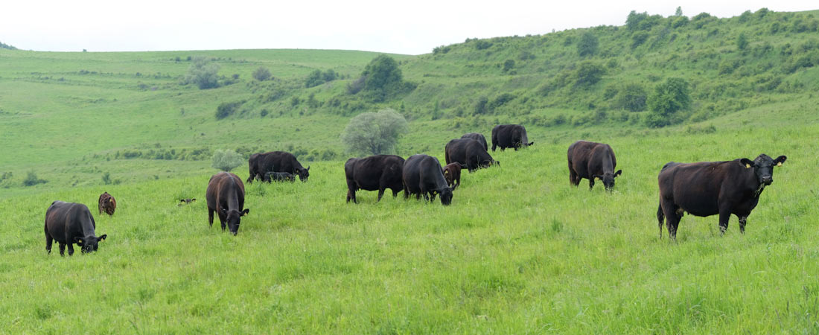
Social Responsibility
1 ˢᵗ Conference on Sustainability COS ’23
Animal Welfare:
Intensive animal farming leads to antibiotic resistance.
EU aims to reduce antibiotic use by 30% by 2030 for healthier individuals, more efficiency, and lower environmental impact.
Consumer Role and Expectations:
Natural, extensive, and organic farming methods are favored with premium support, branding, and higher prices.
Reducing food waste is crucial. In the USA, households waste $2,500 of food annually. Halving beef waste can boost beef sector sustainability by 10%.
In the USA, 38% of all food is unused, equivalent to about 2% of GDP.
Brands in developed countries that ignore sustainability face consumer backlash.
Media plays a significant role in shaping consumer habits.

Slide 8
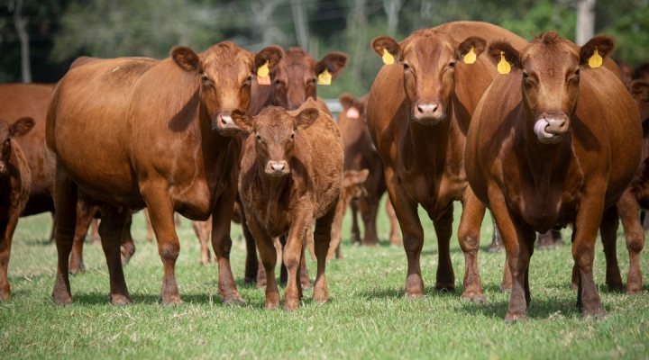
Economic Viability
1 ˢᵗ Conference on Sustainability COS ’23
Bottlenecks:
Cattle farming faces challenges such as low productivity and longer production cycles compared to other animals.
Reproductive output per reproductive live weight is low.
Grazing-based cattle farming in marginal areas is the primary income source in those regions, making communities and households sensitive to price fluctuations.
Beef production efficiency varies by region, with benchmark values: New Zealand (1), North America (1.3), Australia (1.2), South America (0.9), and the EU-27 average (1.5).
EU cattle farms heavily rely on CAP subsidies, making them vulnerable to market fluctuations, especially in EU-N13 countries.
Average income per employee differs significantly, with a 4.5-fold gap between EU15 and EU13 countries.

Slide 9

Economic Viability
1 ˢᵗ Conference on Sustainability COS ’23
Various breeding techniques and technologies are employed, including genetics, SNPs, genomics, and EBV.
Breeding and Reproductive Traits:
Maintaining a calving interval of 365 days is essential.
Heifers should calve by 24 months of age.
Culling rate should be below 5% due to reproductive reasons.
A calving rate over 95% is desired, with careful calf selection.
Easy calving is preferred.
80% of cows should calve within 2 months for spring grazing.
A long useful lifespan and adaptation to extreme weather conditions.
A favorable return on investment for the dam is achieved with 6 calves, 1 or 2 calf losses, and 9 or 10 selected calves.

Slide 10
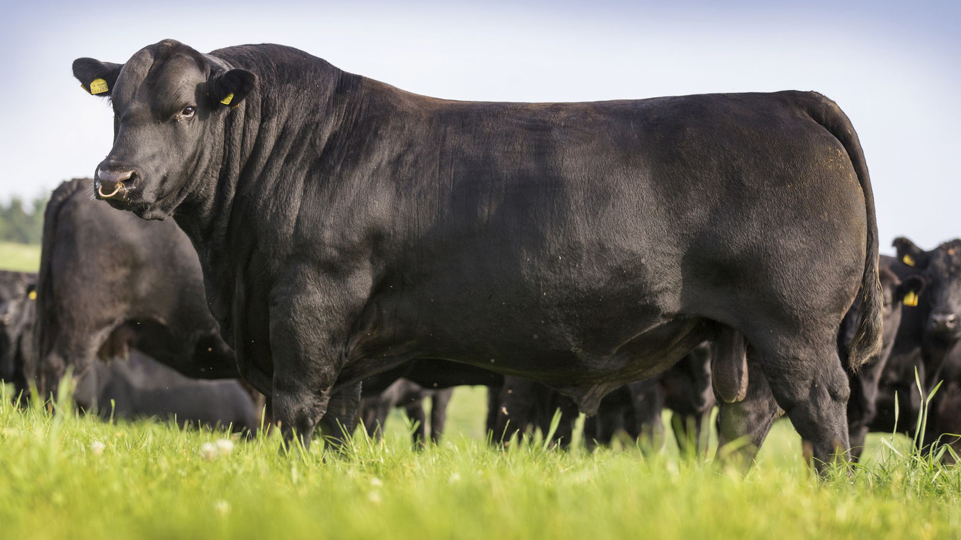
Environmental Awareness
1 ˢᵗ Conference on Sustainability COS ’23
Natural Resource and Ecosystem Protection: Prioritizing soil fertility, biodiversity preservation, air quality, reducing carbon and water footprints, erosion control.
Local Considerations, Marginal Areas: Implementing sustainable practices, lower land use, proper grazing management to promote carbon sequestration.
Methane Emissions: Achieving a 40% reduction in methane emissions per kilogram of beef produced over 50 years in the USA while increasing beef production by 67%.
Breeding for Sustainability: Breeding cows for longevity and high-quality calf production, with benefits including a 10% reduction in methane emissions and a €100 increase in profitability per calving.
Water Footprint: Beef production contributes to 3.7% of the water footprint, while non-basic foods like chocolate, cookies, and alcohol account for 25%.
Upcycling: Repurposing by-products, which make up 44% of live weight, for various industries such as textiles, pharmaceuticals, paints, cosmetics, vitamins, lubricants, brake fluids.

Slide 11
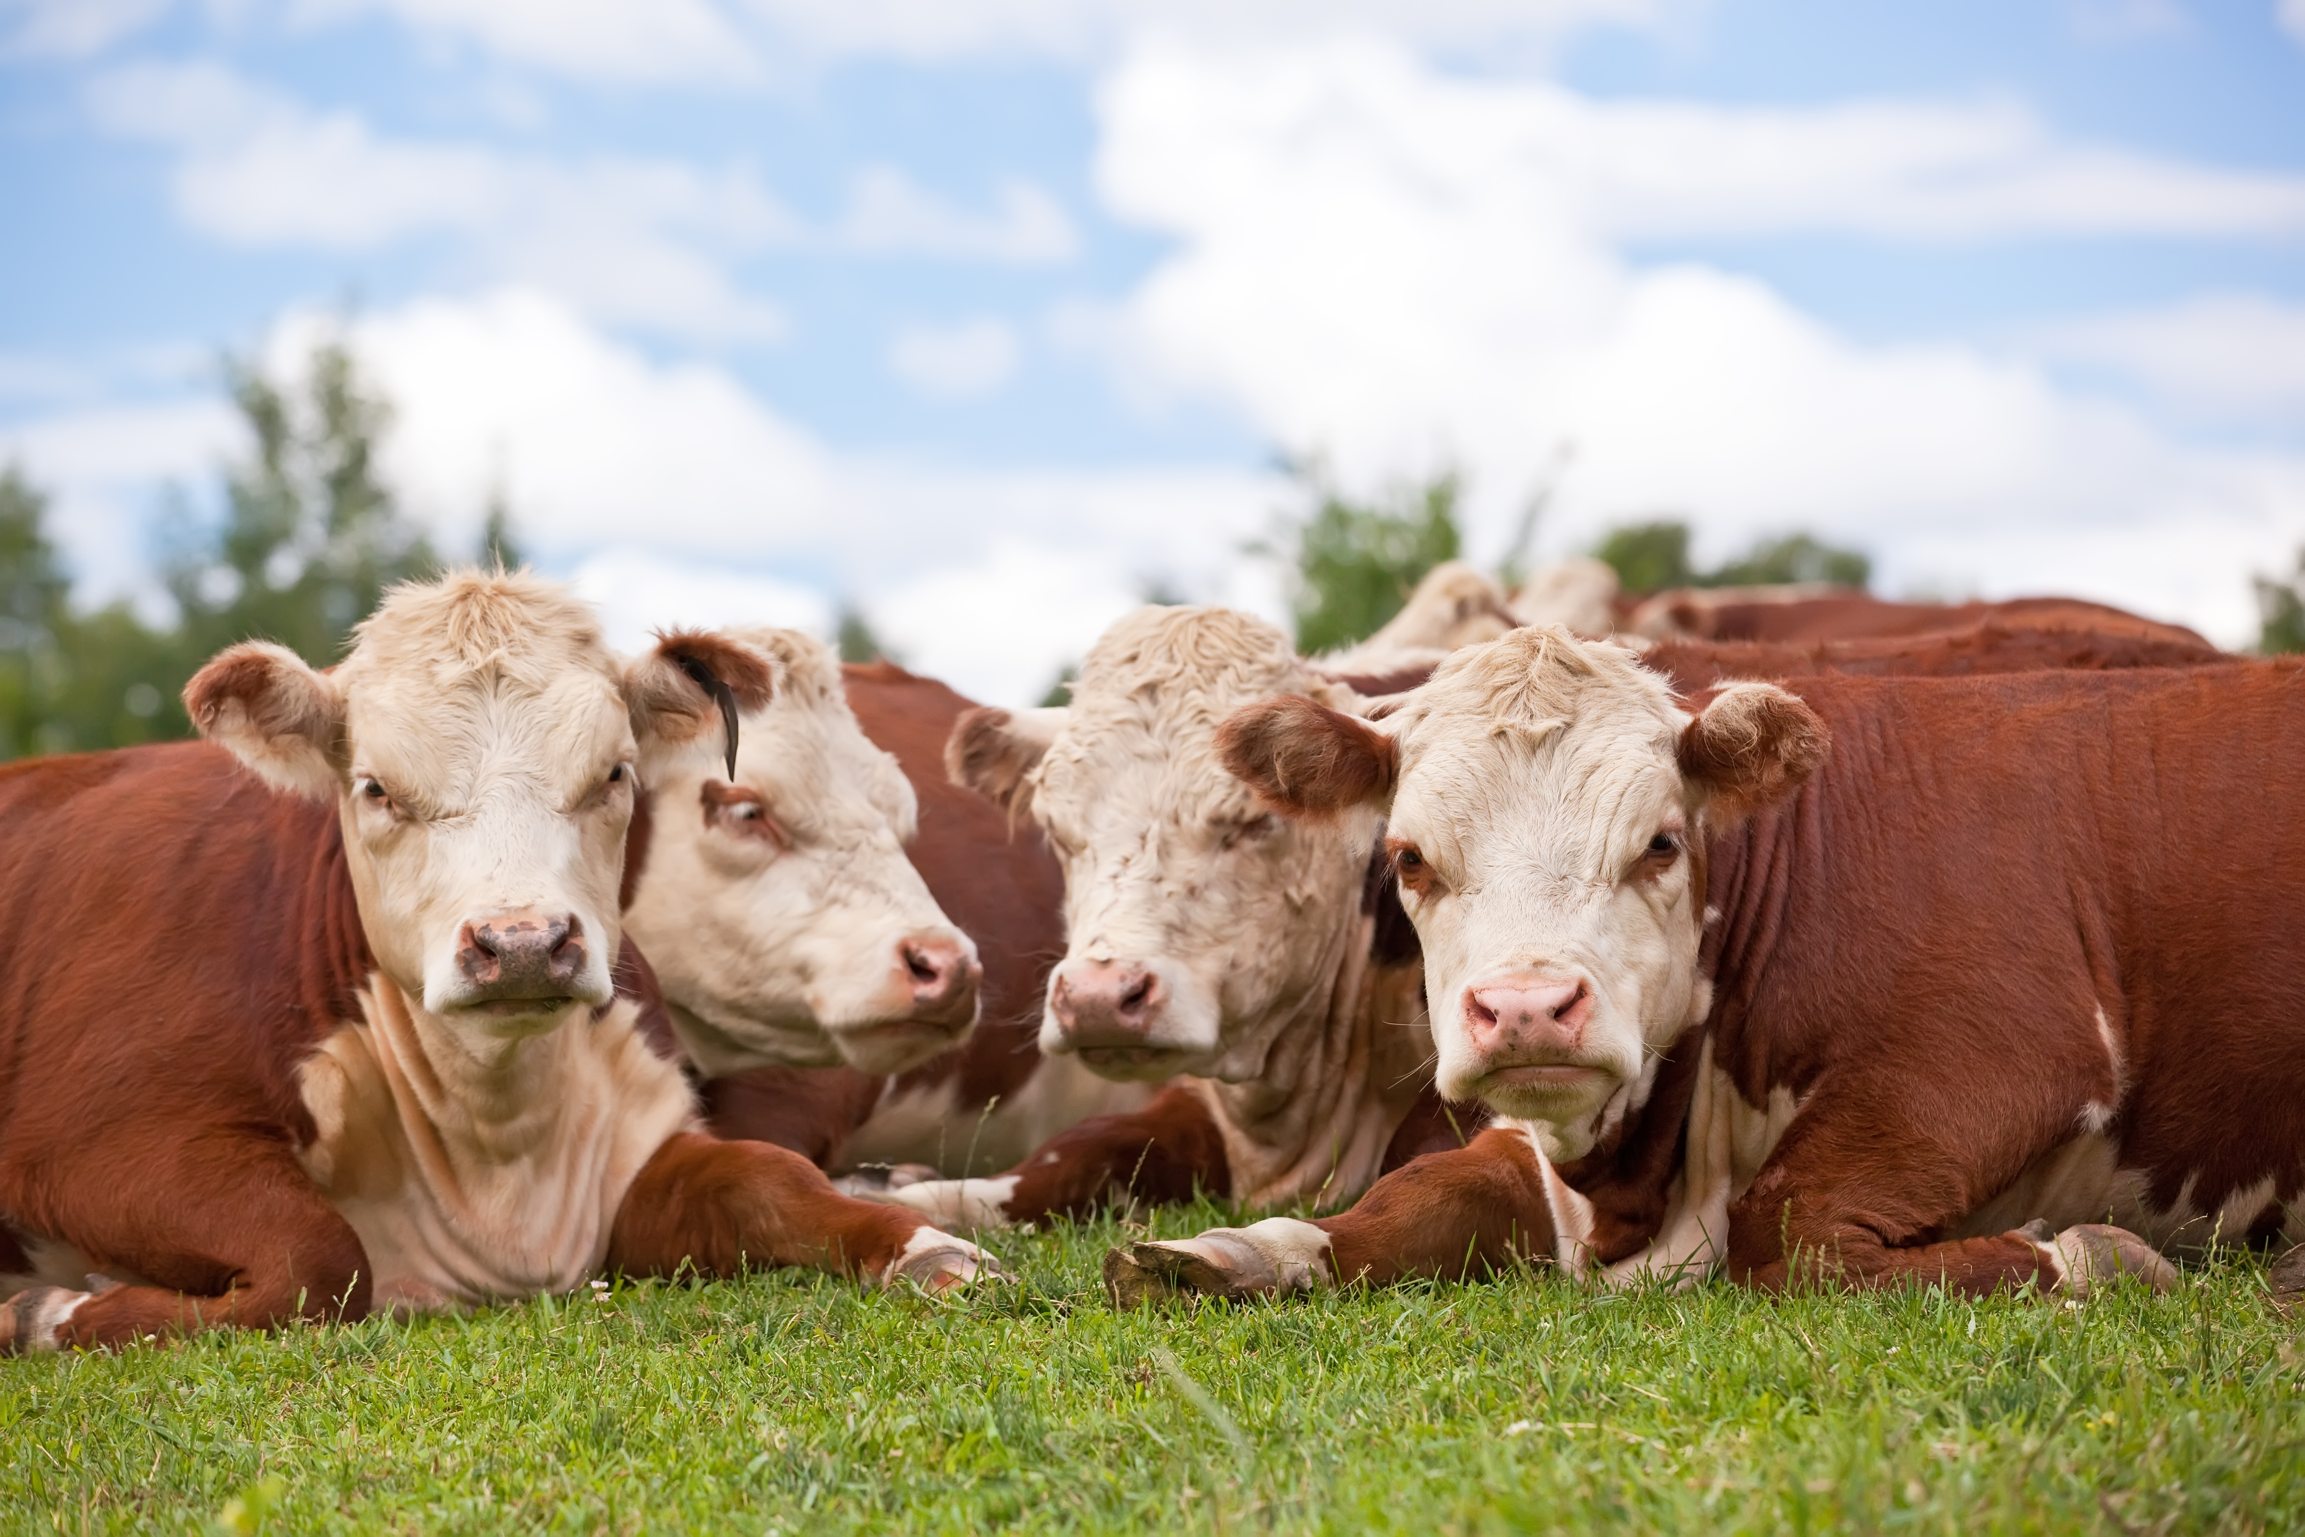

Reaching profitability and sustainability is society’s joint interest and responsibility.
Thank you for your attention!

